Slide 1
Illustration
Ki Hyun Kim

Slide 2
z
x+y
…
x
y

Slide 3
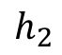
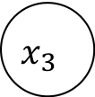
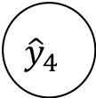
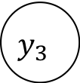
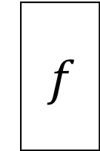
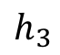

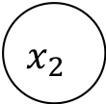
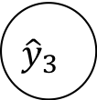
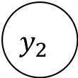
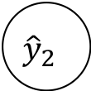
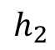
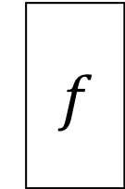
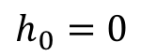

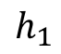
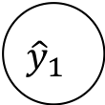
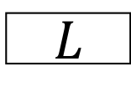
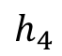
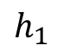
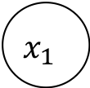
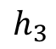
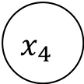
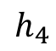
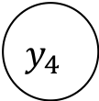
$$y_{1}$$
$$y_{2}$$
$$y_{3}$$
$$y_{4}$$
$$L$$
$${\hat{y}}_{1}$$
$${\hat{y}}_{2}$$
$${\hat{y}}_{3}$$
$${\hat{y}}_{4}$$
$$h_{1}$$
$$h_{2}$$
$$h_{3}$$
$$h_{4}$$
$$f$$
$$f$$
$$f$$
$$f$$
$$h_{0}=0$$
$$h_{1}$$
$$h_{2}$$
$$h_{3}$$
$$h_{4}$$
$$x_{1}$$
$$x_{2}$$
$$x_{3}$$
$$x_{4}$$

Slide 4
$$y_{1}$$
$$y_{2}$$
$$y_{3}$$
$$y_{4}$$
$$L$$
$${\hat{y}}_{1}$$
$${\hat{y}}_{2}$$
$${\hat{y}}_{3}$$
$${\hat{y}}_{4}$$
$$h_{1}$$
$$h_{2}$$
$$h_{3}$$
$$h_{4}$$
$$f$$
$$f$$
$$f$$
$$f$$
$$h_{0}=0$$
$$h_{1}$$
$$h_{2}$$
$$h_{3}$$
$$h_{4}$$
$$x_{1}$$
$$x_{2}$$
$$x_{3}$$
$$x_{4}$$

Slide 5
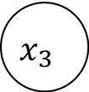
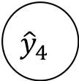
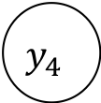
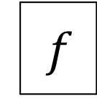
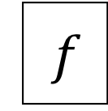


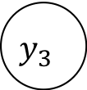
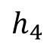

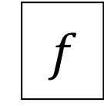


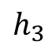
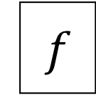

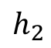
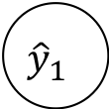



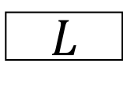
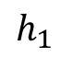
$$y_{1}$$
$$y_{2}$$
$$y_{3}$$
$$y_{4}$$
$$L$$
$${\hat{y}}_{1}$$
$${\hat{y}}_{2}$$
$${\hat{y}}_{3}$$
$${\hat{y}}_{4}$$
$$h_{1}$$
$$h_{2}$$
$$h_{3}$$
$$h_{4}$$
$$f$$
$$f$$
$$f$$
$$f$$
$$f$$
$$f$$
$$f$$
$$f$$
$$f$$
$$f$$
$$f$$
$$f$$
$$x_{1}$$
$$x_{2}$$
$$x_{3}$$
$$x_{4}$$

Slide 6
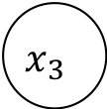


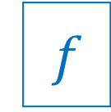
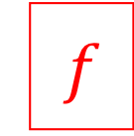
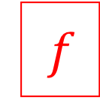
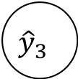
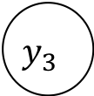
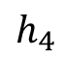


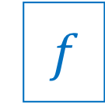
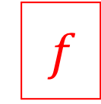

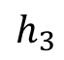
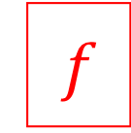

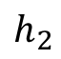
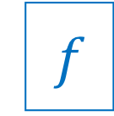






$$y_{1}$$
$$y_{2}$$
$$y_{3}$$
$$y_{4}$$
$$L$$
$${\hat{y}}_{1}$$
$${\hat{y}}_{2}$$
$${\hat{y}}_{3}$$
$${\hat{y}}_{4}$$
$$h_{1}$$
$$f$$
$$h_{2}$$
$$f$$
$$h_{3}$$
$$f$$
$$h_{4}$$
$$f$$
$$f$$
$$f$$
$$f$$
$$f$$
$$f$$
$$f$$
$$f$$
$$f$$
$$f$$
$$f$$
$$f$$
$$f$$
$$f$$
$$f$$
$$f$$
$$f$$
$$f$$
$$f$$
$$f$$
$$f$$
$$x_{1}$$
$$x_{2}$$
$$x_{3}$$
$$x_{4}$$

Slide 7








매우 긍정
…1000…
$$L$$
긍정
…
0.1
0.7
0.2
0.1
…
$$softmax$$
$$h_{1}$$
$$h_{2}$$
$$h_{3}$$
$$h_{4}$$
$$f$$
$$f$$
$$f$$
$$f$$
$$h_{0}$$
$$h_{1}$$
$$h_{2}$$
$$h_{3}$$
$$h_{4}$$
$$emb$$
$$emb$$
$$emb$$
$$emb$$
…0010…
BOS
$$나는$$
$$학교에$$
$$가는$$

Slide 8











$$너는$$
$$직장에$$
$$가는$$
$$것을$$
…1000…
$$L$$
$$나는$$
$$학교에$$
$$가는$$
$$것을$$
…
0.1
0.7
0.2
0.1
…
$$softmax$$
$$softmax$$
$$softmax$$
$$softmax$$
$$h_{1}$$
$$h_{2}$$
$$h_{3}$$
$$h_{4}$$
$$f$$
$$f$$
$$f$$
$$f$$
$$h_{0}$$
$$h_{1}$$
$$h_{2}$$
$$h_{3}$$
$$h_{4}$$
$$emb$$
$$emb$$
$$emb$$
$$emb$$
…0010…
BOS
$$나는$$
$$학교에$$
$$가는$$

Slide 9














$$c_{t−1}$$
x
+
$$c_{t}$$
$$forget(σ)$$
$$f_{t}$$
$$tanh$$
$$h_{t−1}$$
$$output(σ)$$
$$o_{t}$$
x
$$h_{t}$$
$$tanh$$
$$g_{t}$$
x
$$input(σ)$$
$$i_{t}$$
$$x_{t}$$

Slide 10







x
$$reset(σ)$$
$$r_{t}$$
$$h_{t−1}$$
x
+
$$h_{t}$$
$$tanh$$
$$n_{t}$$
$$update(σ)$$
$$z_{t}$$
x
$$x_{t}$$

Slide 11










$${\hat{x}}_{1}$$
$${\hat{x}}_{2}$$
$${\hat{x}}_{3}$$
$${\hat{x}}_{4}$$
$${\hat{x}}_{5}$$
softmax
softmax
softmax
softmax
softmax
rnn cell
rnn cell
rnn cell
rnn cell
rnn cell
rnn cell
rnn cell
rnn cell
rnn cell
rnn cell
embedding
embedding
embedding
embedding
embedding
$$x_{0}$$
$$x_{1}$$
$$x_{2}$$
$$x_{3}$$
$$x_{4}$$

Slide 12
Related meaning
Sense 1
Sense 2
Word 2
Sense 3
Word 1
Sense 4
Sense 5
Related meaning

Slide 13












Generator
$${\hat{y}}_{1}$$
$${\hat{y}}_{2}$$
$${\hat{y}}_{3}$$
$$EOS$$
softmax
softmax
softmax
softmax
Encoder
Decoder
Stacked RNN Cells
Stacked RNN Cells
Stacked RNN Cells
Stacked RNN Cells
Stacked RNN Cells
Stacked RNN Cells
Stacked RNN Cells
Stacked RNN Cells
Embedding
Embedding
Embedding
Embedding
Embedding
Embedding
Embedding
Embedding
$$x_{1}$$
$$x_{2}$$
$$x_{3}$$
$$x_{4}$$
$$BOS$$
$$y_{1}$$
$$y_{2}$$
$$y_{3}$$

Slide 14










$${\hat{y}}_{1}$$
$${\hat{y}}_{2}$$
$${\hat{y}}_{3}$$
Context vector
softmax
softmax
softmax
Attention weight
concat
concat
concat
Concatenated Encoder Output
W
Stacked RNN Cells
Stacked RNN Cells
Stacked RNN Cells
Stacked RNN Cells
Stacked RNN Cells
Stacked RNN Cells
Stacked RNN Cells
● ● ●
Embedding
Embedding
Embedding
Embedding
Embedding
Embedding
Embedding
$$x_{1}$$
$$x_{2}$$
$$x_{3}$$
$$x_{4}$$
$$BOS$$
$$y_{1}$$
$$y_{2}$$

Slide 15
$${\hat{y}}_{1}$$
$${\hat{y}}_{2}$$
$${\hat{y}}_{3}$$
Context vector
softmax
softmax
softmax
Attention weight
concat
concat
concat
Concatenated Encoder Output
W
Stacked RNN Cells
Stacked RNN Cells
Stacked RNN Cells
Stacked RNN Cells
Stacked RNN Cells
Stacked RNN Cells
Stacked RNN Cells
● ● ●
;
;
Embedding
Embedding
Embedding
Embedding
Embedding
Embedding
Embedding
$$x_{1}$$
$$x_{2}$$
$$x_{3}$$
$$x_{4}$$
$$BOS$$
$$y_{1}$$
$$y_{2}$$

Slide 16
학교에
Context
Vector
Linear Transform
0.2
0.8
I | love | to | go | to | school | .
나는
학교에

Slide 17
school
school
school
school
school
school
school
school
I
I
I
I
I
I
I
I
love
love
love
love
love
love
love
love
you
you
you
you
you
you
you
you
BOS
to
to
to
to
to
to
to
to
go
go
go
go
go
go
go
go
eat
eat
eat
eat
eat
eat
eat
eat
EOS
EOS
EOS
EOS
EOS
EOS
EOS
EOS

Slide 18
I | …
<EOS> | …
school | …
go | .3
love | .2
you | …
. | …
to | …
I | …
<EOS> | …
school | …
go | …
love | …
you | …
. | …
to | …
I | …
<EOS> | …
school | .3
go | .4
love | …
you | …
. | …
to | …
I | …
<EOS> | …
school | .2
go | …
love | …
you | …
. | .1
to | .6
I | …
<EOS> | …
school | .2
go | …
love | …
you | …
. | …
to | …
I | …
<EOS> | …
school | …
go | …
love | …
you | …
. | .4
to | …
I | .4
<EOS> | …
school | …
go | .3
love | …
you | .2
. | …
to | …
I | …
<EOS> | …
school | …
go | …
love | .3
you | …
. | …
to | …
I | …
<EOS> | …
school | .2
go | .2
love | …
you | …
. | …
to | .5
I | …
<EOS> | …
school | …
go | …
love | …
you | …
. | …
to | …
I | …
<EOS> | …
school | …
go | …
love | …
you | …
. | …
to | …
I | …
<EOS> | …
school | …
go | …
love | …
you | …
. | .5
to | …
I | …
<EOS> | .6
school | …
go | …
love | …
you | …
. | …
to | …
<BOS>
I | …
<EOS> | …
school | …
go | …
love | …
you | …
. | …
to | …
I | …
<EOS> | …
school | …
go | …
love | …
you | …
. | …
to | …
I | …
<EOS> | …
school | .8
go | …
love | …
you | …
. | …
to | …
I | …
<EOS> | …
school | …
go | …
love | …
you | …
. | …
to | …
I | …
<EOS>
school | …
go | …
love | …
you | …
. | …
to | …
I
<EOS>
school
go
love
you
.
to

Slide 19



$$\frac{Hidden Size}{2}$$
Backward
Forward
Hidden Size
Layer 3
Forward Backward
#layers $×$ #directions
$$=3×2$$
Layer 2
Layer 3
#layers $=3$
Layer 2
Layer 1
Layer 1
Batch Size
Batch Size

Slide 20

Batch Size
or
# Samples
Time-Step
Beam Size

Slide 21

1-word
Word Vector Dim
Beam Size
Beam Size
$$×$$
# Samples
Get Batch
Time-Step
Beam Size
Sequence-to-Sequence
Batch Size
or
# Samples
Translated Fabricated Mini-batch
Separation
and
Collecting

Slide 22
Linear

Slide 23

I love to go to school.

Slide 24


Slide 25


Slide 26


Slide 27


Slide 28


Slide 29


Slide 30


Slide 31


Slide 32


Slide 33


Slide 34


Slide 35




$$σ$$
$$2d$$
$$k$$
$$d$$

Slide 36


Slide 37


Slide 39


Slide 40


Slide 41


Slide 42


Slide 43


Slide 44


Slide 45


Slide 46


Slide 47


Slide 48


Slide 49


Slide 50


Slide 51


Slide 52


Slide 53


Slide 54


Slide 55


Slide 56


